Slide 1
These slides constitute supporting material to Impact Evaluation in Practice, second edition by Gertler, P.; Martinez, S., Premand, P., Rawlings, L. B. and Vermeersch C., 2016, The World Bank, Washington DC, www.worldbank.org/ieinpractice.
The content of these slides reflects the views of the authors and not necessarily those of the World Bank.
The slides may be adapted and reused under Creative Commons attribution.

Slide 2
MEASURING IMPACT
Impact Evaluation Methods for Policy Makers
Adapted from: Impact Evaluation in Practice Handbook : Gertler, P. J.; Martinez, S., Premand, P., Rawlings, L. B. and Christel M. J. Vermeersch, 2016, Impact Evaluation in Practice, second edition: additional material, The World Bank, Washington DC (www.worldbank.org/ieinpractice).

Slide 3

Portuguese and Spanish Versions also available www.worldbank.org/ieinpractice
Reference

Slide 4
Impact Evaluation
How the program works in theory
Logical Framework
Measuring Impact
Method to identify impact
Data
Operational Plan
Resources

Slide 5
1
Counterfactuals
Incorrect Counterfactuals
Before & After (Pre & Post)
Enrolled & Not Enrolled (Apples & Oranges)
Causal Inference

Slide 6
2
Randomized Assignment
Randomized Promotion
Discontinuity Design
Difference-in-Differences
Diff-in-Diff
IE Methods Toolbox
Matching
P-Score matching

Slide 7
1
Counterfactuals
Incorrect Counterfactuals
Before & After (Pre & Post)
Enrolled & Not Enrolled (Apples & Oranges)
Causal Inference

Slide 8
Our Objective
“
Estimate the causal effect (impact) of intervention (P) on outcome (Y).
(P) = Program or Treatment
(Y) = Indicator, Measure of Success
Example: What is the effect of a Cash Transfer Program (P) on Household Consumption (Y)?

Slide 9
Causal Inference
What is the impact of (P) on (Y)?
α= (Y | P=1)-(Y | P=0)
Can we all go home?

Slide 10
Problem of Missing Data
α= (Y | P=1)-(Y | P=0)
For a program beneficiary:
we observe
(Y | P=1): Household Consumption (Y) with a cash transfer program (P=1)
but we do not observe
(Y | P=0): Household Consumption (Y) without a cash transfer program (P=0)

Slide 11
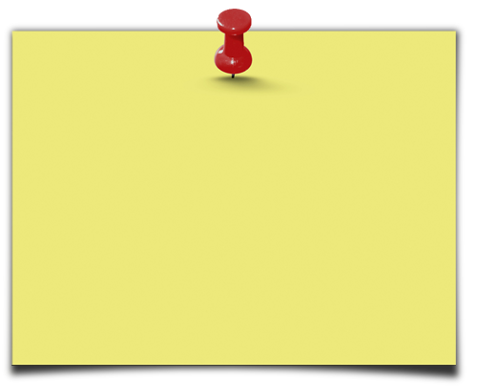
Solution
Estimate what would have happened to Y in the absence of P.
Counterfactual.
We call this the
The key to a good impact evaluation is a valid estimate of the counterfactual!

Slide 12
Estimating impact of P on Y
α= (Y | P=1)-(Y | P=0)
OBSERVE (Y | P=1)
Outcome with treatment
ESTIMATE (Y | P=0)
The Counterfactual
IMPACT = - counterfactual
Outcome with treatment
Intention to Treat (ITT) –Those offered treatment
Treatment on the Treated (TOT) – Those receiving treatment
Use comparison or control group

Slide 13



Example: What is the Impact of…
giving John
additional pocket money
(P)
on John’s consumption of sweets
(Y)?

Slide 14



The Perfect Clone
John
John’s Clone
6 sweets
4 sweets
IMPACT=6-4=2 Sweets

Slide 15




In reality, use statistics
Treatment
Comparison
Average Y=6 sweets
Average Y=4 sweets
IMPACT=6-4=2 Sweets

Slide 16
Finding good comparison groups
We want to find clones for the Johns in our programs.
The treatment and comparison groups should
have identical characteristics
except for benefiting from the intervention.
In practice, use program eligibility & assignment rules to construct valid estimates of the counterfactuals
Notes:
For presentation (with animation effects)

Slide 17
Finding good comparison groups
We want to find clones for the Johns in our programs.
The treatment and comparison groups should
have identical characteristics
except for benefiting from the intervention.
With a good comparison group, the only reason for different outcomes between treatments and comparisons is the intervention (P)
In practice, use program eligibility & assignment rules to construct valid estimates of the counterfactuals
Notes:
For presentation (with animation effects)

Slide 18
Case Study: Progresa
National anti-poverty program in Mexico
Cash Transfers conditional on school and health care attendance.
Operational Rules:
Targeting:
Eligibility based on a poverty index
Timing:
Started 1997
Phased Roll-out, 5 million beneficiaries by 2004

Slide 19
Case Study: Progresa
Rigorous impact evaluation with rich data
506 communities, 24,000 households
Baseline 1997, follow-up 2008
Many outcomes of interest
Here: Consumption per capita
What is the effect of Progresa (P) on Consumption Per Capita (Y)?
If impact is a increase of $20 or more, then scale up nationally

Slide 20
Eligibility and Enrollment
Ineligibles
(Non-Poor)
Eligibles
(Poor)
Not Enrolled
Enrolled
Notes:
For presentation (with animation effects)

Slide 21
1
Counterfactuals
Incorrect Counterfactuals
Before & After (Pre & Post)
Enrolled & Not Enrolled (Apples & Oranges)
Causal Inference

Slide 22


Incorrect Counterfactual #1
Before & After
Y
A
A-C = 2
C (counterfactual)
IMPACT?
A-B = 4
B
Time
T=0
Baseline
T=1
Endline

Slide 23
Case 1: Before & After
What is the effect of Progresa (P) on consumption (Y)?
Y
(1) Observe only beneficiaries (P=1)
(2) Two observations in time:
Consumption at T=0
and consumption at T=1.
268
A
α = $35
233
B
Time
T=1997
T=1998
IMPACT=A-B= $35

Slide 24
Case 1: Before & After
Consumption (Y)
Outcome with Treatment (After) | 268.7
Counterfactual (Before) | 233.4
Impact (Y | P=1) - (Y | P=0) | 35.3***
Estimated Impact on Consumption (Y)
Linear Regression | 35.27**
Multivariate Linear Regression | 34.28**
Note: If the effect is statistically significant at the 1% significance level, we label the estimated impact with 2 stars (**).

Slide 25
Case 1: What’s the problem?
Economic Boom:
Real Impact=A-C
A-B is an overestimate
Y
268
A
Impact?
α = $35
Economic Recession:
Real Impact=A-D
A-B is an underestimate
C ?
Impact?
233
B
D ?
Time
T=0
T=1
Before & After doesn’t control for other time-varying factors!

Slide 26
1
Counterfactuals
Incorrect Counterfactuals
Before & After (Pre & Post)
Enrolled & Not Enrolled (Apples & Oranges)
Causal Inference

Slide 27


Incorrect Counterfactual #2
Enrolled & Not Enrolled
If we have post-treatment data on
Enrolled: treatment group
Not-enrolled: “comparison” group (counterfactual)
Those ineligible to participate.
Those that choose NOT to participate.
Selection Bias
Reason for not enrolling may be correlated with outcome (Y)
Control for observables.
But not un-observables!
Estimated impact is confounded with other things.

Slide 28
Case 2: Enrolled & Not Enrolled
Measure outcomes in post-treatment (T=1)
Ineligibles
(Non-Poor)
Eligibles
(Poor)
Not Enrolled
Y=290
Enrolled
Y=268
In what ways might E&NE be different, other than their enrollment in the program?
Notes:
For presentation (with animation effects)

Slide 29
Case 2: Enrolled & Not Enrolled
Consumption (Y)
Outcome with Treatment (Enrolled) | 268
Counterfactual (Not Enrolled) | 290
Impact (Y | P=1) - (Y | P=0) | -22**
Estimated Impact on Consumption (Y)
Linear Regression | -22**
Multivariate Linear Regression | -4.15
Note: If the effect is statistically significant at the 1% significance level, we label the estimated impact with 2 stars (**).

Slide 30
Progresa Policy Recommendation?
Impact on Consumption (Y)
Case 1: Before & After | Linear Regression | 35.27**
 | Multivariate Linear Regression | 34.28**
Case 2: Enrolled & Not Enrolled | Linear Regression | -22**
 | Multivariate Linear Regression | -4.15
Will you recommend scaling up Progresa?
B&A: Are there other time-varying factors that also influence consumption?
E&BNE:
Are reasons for enrolling correlated with consumption?
Selection Bias.
Note: If the effect is statistically significant at the 1% significance level, we label the estimated impact with 2 stars (**).

Slide 31
Keep in Mind
!
B&A
E&NE
Compare: Same individuals Before and After they receive P.
Compare: Group of individuals Enrolled in a program with group that chooses not to enroll.
Problem: Other things may have happened over time.
Problem: Selection Bias. We don’t know why they are not enrolled.
Both counterfactuals may lead to biased estimates of the counterfactual and the impact.

Slide 32
2
Randomized Assignment
Randomized Promotion
Discontinuity Design
Difference-in-Differences
Diff-in-Diff
IE Methods Toolbox
Matching
P-Score matching

Slide 33
Choosing your IE method(s)
Key information you will need for choosing the right method for your program:
Prospective/Retrospective Evaluation?
Targeting rules and criteria?
Poverty targeting?
Geographic targeting?
Timing: Roll-out plan (pipeline)?
Money: Is the number of eligible units larger than available resources at a given point in time?
Budget and capacity constraints?
Excess demand for program?
Etc.

Slide 34
Choosing your IE method(s)
Choose the best possible design given the operational context:
Best Design
Best comparison group you can find + least operational risk
Have we controlled for everything?
Internal validity
Good comparison group
External validity
Local versus global treatment effect
Evaluation results apply to population we’re interested in
Is the result valid for everyone?

Slide 35
2
Randomized Assignment
Randomized Promotion
Discontinuity Design
Difference-in-Differences
Diff-in-Diff
IE Methods Toolbox
Matching
P-Score matching

Slide 36
Randomized Treatments & Comparison
Eligibles > Number of Benefits
Randomize!
Lottery for who is offered benefits
Fair, transparent and ethical way to assign benefits to equally deserving populations.
Oversubscription
Give each eligible unit the same chance of receiving treatment
Compare those offered treatment with those not offered treatment (comparisons).
Randomized Phase In
Give each eligible unit the same chance of receiving treatment first, second, third…
Compare those offered treatment first, with those offered later (comparisons).

Slide 37

Randomized treatments and comparisons
1. Eligible Population
= Ineligible
= Eligible
External Validity
Notes:
For printing (max size for better detail)

Slide 38



2. Evaluation sample
3. Randomize Treatment
External Validity
Internal Validity
Notes:
For printing (max size for better detail)

Slide 39
















Randomized treatments and comparisons
3. Randomize treatment
1. Population
2. Evaluation sample
X
Comparison
Treatment
= Ineligible
External Validity
Internal Validity
= Eligible
Notes:
For presentation (with animation effects)

Slide 40
Unit of Randomization
Choose according to type of program
Individual/Household
School/Health Clinic/catchment area
Block/Village/Community
Ward/District/Region
As a rule of thumb, randomize at the smallest viable unit of implementation.
Keep in mind
Need “sufficiently large” number of units to detect minimum desired impact: Power.
Spillovers/contamination
Operational and survey costs

Slide 41
Case 3: Randomized Assignment
Progresa CCT program
Unit of randomization: Community
506 communities in the evaluation sample
Randomized phase-in
320 treatment communities (14446 households):
First transfers in April 1998.
186 comparison communities (9630 households):
First transfers November 1999

Slide 42

Case 3: Randomized Assignment
T=0
T=1
320
Time
Treatment Communities
186
Comparison Communities
Comparison Period

Slide 43
Case 3: Randomized Assignment
How do we know we have good clones?
In the absence of Progresa, treatment and comparisons should be identical
Let’s compare their characteristics at baseline (T=0)

Slide 44
Case 3: Balance at Baseline
Case 3: Randomized Assignment
 | Treatment | Comparison | T-stat
Consumption ($ monthly per capita) | 233.4 | 233.47 | -0.39
Head’s age (years) | 41.6 | 42.3 | -1.2
Spouse’s age (years) | 36.8 | 36.8 | -0.38
Head’s education (years) | 2.9 | 2.8 | 2.16**
Spouse’s education (years) | 2.7 | 2.6 | 0.006
Note: If the effect is statistically significant at the 1% significance level, we label the estimated impact with 2 stars (**).

Slide 45
Case 3: Balance at Baseline
Case 3: Randomized Assignment
 | Treatment | Comparison | T-stat
Head is female=1 | 0.07 | 0.07 | -0.66
Indigenous=1 | 0.42 | 0.42 | -0.21
Number of household members | 5.7 | 5.7 | 1.21
Bathroom=1 | 0.57 | 0.56 | 1.04
Hectares of Land | 1.67 | 1.71 | -1.35
Distance to Hospital (km) | 109 | 106 | 1.02
Note: If the effect is statistically significant at the 1% significance level, we label the estimated impact with 2 stars (**).

Slide 46
Case 3: Randomized Assignment
 | Treatment Group (Randomized to treatment) | Counterfactual (Randomized to Comparison) | Impact (Y | P=1) - (Y | P=0)
Baseline (T=0) Consumption (Y) | 233.47 | 233.40 | 0.07
Follow-up (T=1) Consumption (Y) | 268.75 | 239.5 | 29.25**
Estimated Impact on Consumption (Y)
Linear Regression | 29.25**
Multivariate Linear Regression | 29.75**
Note: If the effect is statistically significant at the 1% significance level, we label the estimated impact with 2 stars (**).

Slide 47
Progresa Policy Recommendation?
Impact of Progresa on Consumption (Y)
Case 1: Before & After | Multivariate Linear Regression | 34.28**
Case 2: Enrolled & Not Enrolled | Linear Regression | -22**
 | Multivariate Linear Regression | -4.15
Case 3: Randomized Assignment | Multivariate Linear Regression | 29.75**
Note: If the effect is statistically significant at the 1% significance level, we label the estimated impact with 2 stars (**).

Slide 48

Keep in Mind
!
Randomized Assignment
In Randomized Assignment, large enough samples, produces 2 statistically equivalent groups.
Feasible for prospective evaluations with over-subscription/excess demand.
Most pilots and new programs fall into this category.
We have identified the perfect clone.
Randomized
beneficiary
Randomized
comparison

Slide 49

Randomized assignment with different benefit levels
Traditional impact evaluation question:
What is the impact of a program on an outcome?
Other policy question of interest:
What is the optimal level for program benefits?
What is the impact of a “higher-intensity” treatment compared to a “lower-intensity” treatment?
Randomized assignment with 2 levels of benefits:
Comparison | Low Benefit | High Benefit
X

Slide 50




Randomized assignment with different benefit levels
3. Randomize treatment
(2 benefit levels)
1. Eligible Population
2. Evaluation sample
X
= Ineligible
= Eligible
Notes:
For presentation (with animation effects)

Slide 51

Randomized assignment with multiple interventions
Other key policy question for a program with various benefits:
What is the impact of an intervention compared to another?
Are there complementarities between various interventions?
Randomized assignment with 2 benefit packages:
 |  | Intervention 1
 |  | Treatment | Comparison
Intervention 2 | Treatment | Group A | Group C
 | Comparison | Group B | Group D X

Slide 52










Randomized assignment with multiple interventions
4. Randomize intervention 2
3. Randomize intervention 1
1. Eligible Population
2. Evaluation sample
X
= Ineligible
= Eligible
Notes:
For presentation (with animation effects)

Slide 53
2
Randomized Assignment
Randomized Promotion
Discontinuity Design
Difference-in-Differences
Diff-in-Diff
IE Methods Toolbox
Matching
P-Score matching

Slide 54
What if we can’t choose?
It’s not always possible to choose a control group. What about:
National programs where everyone is eligible?
Programs where participation is voluntary?
Programs where you can’t exclude anyone?
Can we compare Enrolled & Not Enrolled?
Selection Bias!

Slide 55
Randomly offering or promoting program
If you can exclude some units, but can’t force anyone:
Offer the program to a random sub-sample
Many will accept
Some will not accept
Randomized offering
If you can’t exclude anyone, and can’t force anyone:
Making the program available to everyone
But provide additional promotion, encouragement or incentives to a random sub-sample:
Additional Information.
Encouragement.
Incentives (small gift or prize).
Transport (bus fare).
Randomized promotion

Slide 56
Randomly offering or promoting program
Necessary conditions:
Offered/promoted and not-offered/ not-promoted groups are comparable:
Whether or not you offer or promote is not correlated with population characteristics
Guaranteed by randomization.
Offered/promoted group has higher enrollment in the program.
Offering/promotion of program does not affect outcomes directly.

Slide 57



Randomly offering or promoting program
3 groups of units/individuals
 | WITH promotion | WITHOUT promotion
Never Enroll
Only Enroll if Encouraged
Always Enroll

Slide 58
Randomly offering or promoting program
Universal units
Eligible
Enroll | Never | Promotion | Always
Notes:
For printing (max size for better detail)

Slide 59

Randomize promotion/ offering the program
Enrollment
No Promotion
X
X
Promotion
Notes:
For printing (max size for better detail)

Slide 60













Randomly offering or promoting program
Randomize promotion/ offering the program
Enrollment
Eligible units
X
No Promotion
X
0
Promotion
Eligible
Enroll | Never | Promotion | Always
Notes:
For presentation (with animation effects)

Slide 61

Randomly offering or promoting program
 | Promoted Group | Not Promoted Group | Impact
 | %Enrolled=80% Average Y for entire group=100 | %Enrolled=30% Average Y for entire group=80 | ∆Enrolled=50% ∆Y=20 Impact= 20/50%=40
Never Enroll
Only Enroll if Encouraged
Always Enroll
-
-

Slide 62
Examples: Randomized Promotion
Maternal Child Health Insurance in Argentina
Intensive information campaigns
Community Based School Management in Nepal
NGO helps with enrollment paperwork

Slide 63
Community Based School Management in Nepal
Context:
A centralized school system
2003: Decision to allow local administration of schools
The program:
Communities express interest to participate.
Receive monetary incentive ($1500)
What is the impact of local school administration on:
School enrollment, teachers absenteeism, learning quality, financial management
Randomized promotion:
NGO helps communities with enrollment paperwork.
40 communities with randomized promotion (15 participate)
40 communities without randomized promotion (5 participate)

Slide 64
Maternal Child Health Insurance in Argentina
Context:
2001 financial crisis
Health insurance coverage diminishes
Pay for Performance (P4P) program:
Change in payment system for providers.
40% payment upon meeting quality standards
What is the impact of the new provider payment system on health of pregnant women and children?
Randomized promotion:
Universal program throughout the country.
Randomized intensive information campaigns to inform women of the new payment system and increase the use of health services.

Slide 65
Case 4: Randomized Promotion
Randomized Promotion is an “Instrumental Variable” (IV)
A variable correlated with treatment but nothing else (i.e. randomized promotion)
Use 2-stage least squares (see annex)
When you randomly choose the units to which you offer the treatment but have less than 100% take-up
Using this method is equivalent to estimating the effect of “treatment on the treated”
How?
“promoted” group = group offered treatment.
“not promoted” group = group not offered treatment.

Slide 66
Case 4: Progresa Randomized Promotion
 | Promoted Group | Not Promoted Group | Impact
 | %Enrolled=92% Average Y for entire group = 268 | %Enrolled=0% Average Y for entire group = 239 | ∆Enrolled=0.92 ∆Y=29 Impact= 29/0.92 =31
Never Enroll |  |  | -
Enroll if Encouraged
Always Enroll | - | - | -

Slide 67
Case 4: Randomized Promotion
Estimated Impact on Consumption (Y)
Instrumental Variables Regression | 29.8**
Instrumental Variables with Controls | 30.4**
Note: If the effect is statistically significant at the 1% significance level, we label the estimated impact with 2 stars (**).

Slide 68
Keep in Mind
!
Randomized Promotion
Randomized Promotion needs to be an effective promotion strategy
(Pilot test in advance!)
Don’t exclude anyone but…
Strategy depends on success and validity of promotion.
Promotion strategy will help understand how to increase enrollment in addition to impact of the program.
Strategy estimates a local average treatment effect. Impact estimate valid only for the triangle hat type of beneficiaries.

Slide 69
2
Randomized Assignment
Randomized Promotion
Discontinuity Design
Difference-in-Differences
Diff-in-Diff
IE Methods Toolbox
Matching
P-Score matching

Slide 70
Discontinuity Design
Many social programs select beneficiaries using an index or score:
Anti-poverty Programs
Targeted to households below a given poverty index/income
Pensions
Targeted to population above a certain age
Scholarships targeted to students with high scores on standarized text
Education
Fertilizer program targeted to small farms less than given number of hectares)
Agriculture

Slide 71
Example: Effect of fertilizer program on agriculture production
Goal
Improve school attendance for poor students
Method
Households with a score (Pa) of assets ≤50 are poor
Households with a score (Pa) of assets >50 are not poor
Intervention
Poor households receive scholarships to send children to school

Slide 72
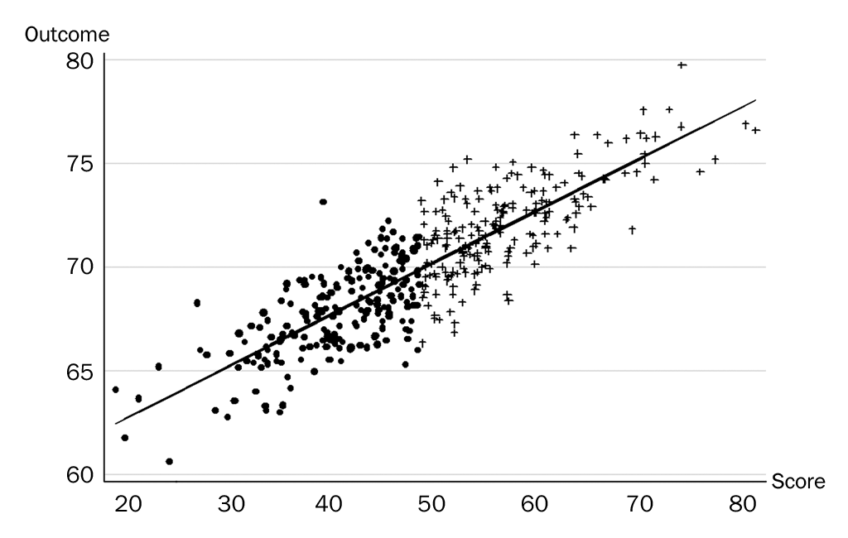
Regression Discontinuity Design-Baseline
Not eligible
Eligible

Slide 73
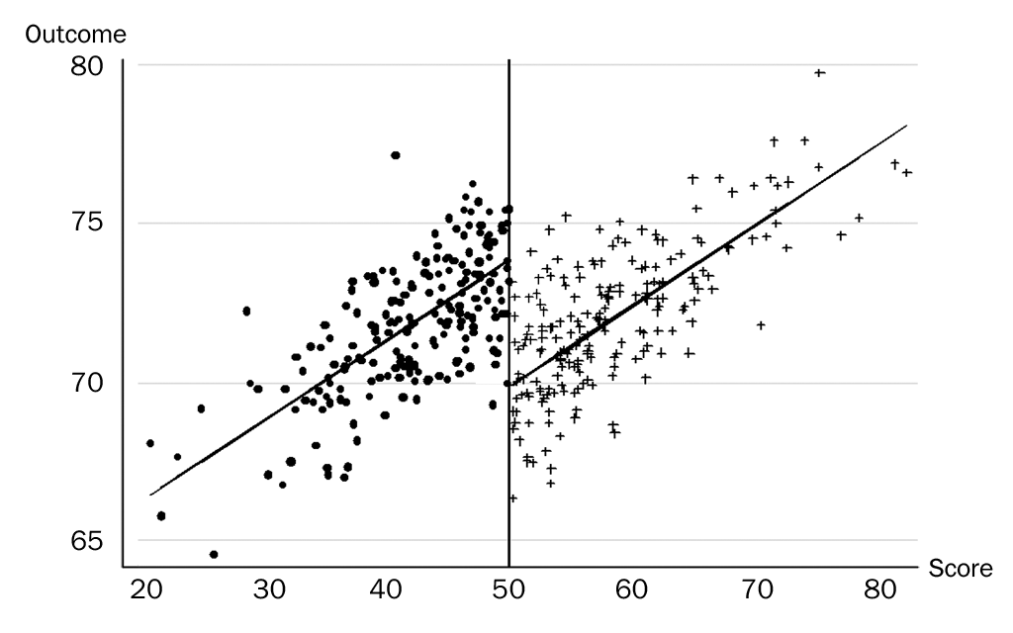
Regression Discontinuity Design-Post Intervention
IMPACT

Slide 74
Case 5: Discontinuity Design
We have a continuous eligibility index with a defined cut-off
Households with a score ≤ cutoff are eligible
Households with a score > cutoff are not-eligible
Or vice-versa
Intuitive explanation of the method:
Units just above the cut-off point are very similar to units just below it – good comparison.
Compare outcomes Y for units just above and below the cut-off point.
Notes:
For printing only

Slide 75
Case 5: Discontinuity Design
We have a continuous eligibility index with a defined cut-off
Households with a score ≤ cutoff are eligible
Households with a score > cutoff are not eligible
Or vice-versa
Intuitive explanation of the method:
Units just above the cut-off point are very similar to units just below it – good comparison.
Compare outcomes Y for units just above and below the cut-off point.
For a discontinuity design, you need:
Continuous eligibility index
Clearly defines eligibility cut-off.
Notes:
For presentation (with animation effects)

Slide 76
Case 5: Discontinuity Design
Eligibility for Progresa is based on national poverty index
Household is poor if score ≤ 750
Eligibility for Progresa:
Eligible=1 if score ≤ 750
Eligible=0 if score > 750

Slide 77
Case 5: Discontinuity Design Score vs. consumption at Baseline-No treatment
Consumption
Fitted values
Poverty Index

Slide 78
Case 5: Discontinuity Design Score vs. consumption post-intervention period-treatment
Consumption
Fitted values
30.58**
Estimated impact on consumption (Y) | Multivariate Linear Regression
Poverty Index

Slide 79
Keep in Mind
!
Discontinuity Design
Discontinuity Design requires continuous eligibility criteria with clear cut-off.
No need to exclude a group of eligible households/ individuals from treatment.
Gives unbiased estimate of the treatment effect: Observations just across the cut-off are good comparisons.
Can sometimes use it for programs that already ongoing.

Slide 80
Keep in Mind
!
Discontinuity Design
Discontinuity Design produces a local estimate:
Effect of the program around the cut-off point/discontinuity.
This is not always generalizable.
Power:
Need many observations
around the cut-off point.
Avoid mistakes in the statistical model: Sometimes what looks like a discontinuity in the graph, is something else.

Slide 81
2
Randomized Assignment
Randomized Promotion
Discontinuity Design
Difference-in-Differences
Diff-in-Diff
IE Methods Toolbox
Matching
P-Score matching

Slide 82
Difference-in-differences (Diff-in-diff)
Y=Wages
P=Youth employment program
 | Enrolled | Not Enrolled
After | 0.74 | 0.81
Before | 0.60 | 0.78
-
-
-
Difference | +0.14 | +0.03
=
0.11
Diff-in-Diff: Impact=(Y_{t1}-Y_{t0})-(Y_{c1}-Y_{c0})

Slide 83
Difference-in-differences (Diff-in-diff)
Y=School attendance
P=Girls’ scholarship program
 | Enrolled | Not Enrolled
After | 0.74 | 0.81
Before | 0.60 | 0.78
Difference
-0.07
-0.18
-
-
-
=
0.11
Diff-in-Diff: Impact=(Y_{t1}-Y_{c1})-(Y_{t0}-Y_{c0})

Slide 84
Impact =(A-B)-(C-D)=(A-C)-(B-D)
Not enrolled
C=0.81
School Attendance
D=0.78
A=0.74
Enrolled
Impact=0.11
B=0.60
T=0
T=1
Time

Slide 85
Impact =(A-B)-(C-D)=(A-C)-(B-D)
Not enrolled
C=0.81
School Attendance
D=0.78
A=0.74
Enrolled
Impact<0.11
B=0.60
T=0
T=1
Time

Slide 86
Case 6: Difference in difference
 | Enrolled | Not Enrolled | Difference
Follow-up (T=1) Consumption (Y) | 268.75 | 290 | -21.25
Baseline (T=0) Consumption (Y) | 233.47 | 281.74 | -48.27
Difference | 35.28 | 8.26 | 27.02
Estimated Impact on Consumption (Y)
Linear Regression | 27.06**
Multivariate Linear Regression | 25.53**
Note: If the effect is statistically significant at the 1% significance level, we label the estimated impact with 2 stars (**).

Slide 87
Progresa Policy Recommendation?
Impact of Progresa on Consumption (Y)
Case 1: Before & After | 34.28**
Case 2: Enrolled & Not Enrolled | -4.15
Case 3: Randomized Assignment | 29.75**
Case 4: Randomized Promotion | 30.4**
Case 5: Discontinuity Design | 30.58**
Case 6: Difference-in-Differences | 25.53**
Note: If the effect is statistically significant at the 1% significance level, we label the estimated impact with 2 stars (**).

Slide 88
Keep in Mind
!
Difference-in-Differences
Differences in Differences combines Enrolled & Not Enrolled with Before & After.
To test this, at least 3 observations in time are needed:
2 observations before
1 observation after.
Slope: Generate counterfactual for change in outcome
Trends –slopes- are the same in treatments and comparisons
(Fundamental assumption).

Slide 89
2
Randomized Assignment
Randomized Promotion
Discontinuity Design
Difference-in-Differences
Diff-in-Diff
IE Methods Toolbox
Matching
P-Score matching

Slide 90
Matching
Idea
For each treated unit pick up the best comparison unit (match) from another data source.
How?
Matches are selected on the basis of similarities in observed characteristics.
Issue?
If there are unobservable characteristics and those unobservables influence participation: Selection bias!

Slide 91
Propensity-Score Matching (PSM)
Comparison Group: non-participants with same observable characteristics as participants.
In practice, it is very hard.
There may be many important characteristics!
Match on the basis of the “propensity score”, Solution proposed by Rosenbaum and Rubin:
Compute everyone’s probability of participating, based on their observable characteristics.
Choose matches that have the same probability of participation as the treatments.
See appendix 2.

Slide 92
Density of propensity scores
Density
Non-Participants
Participants
Common Support
0
Propensity Score
1

Slide 93
Case 7: Progresa Matching (P-Score)
Baseline Characteristics | Estimated Coefficient Probit Regression, Prob Enrolled=1
Head’s age (years) | -0.022**
Spouse’s age (years) | -0.017**
Head’s education (years) | -0.059**
Spouse’s education (years) | -0.03**
Head is female=1 | -0.067
Indigenous=1 | 0.345**
Number of household members | 0.216**
Dirt floor=1 | 0.676**
Bathroom=1 | -0.197**
Hectares of Land | -0.042**
Distance to Hospital (km) | 0.001*
Constant | 0.664**
Note: If the effect is statistically significant at the 1% significance level, we label the estimated impact with 2 stars (**).

Slide 94
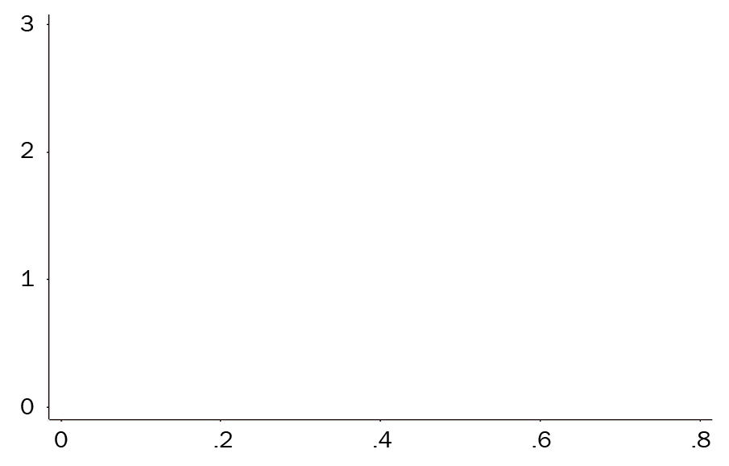
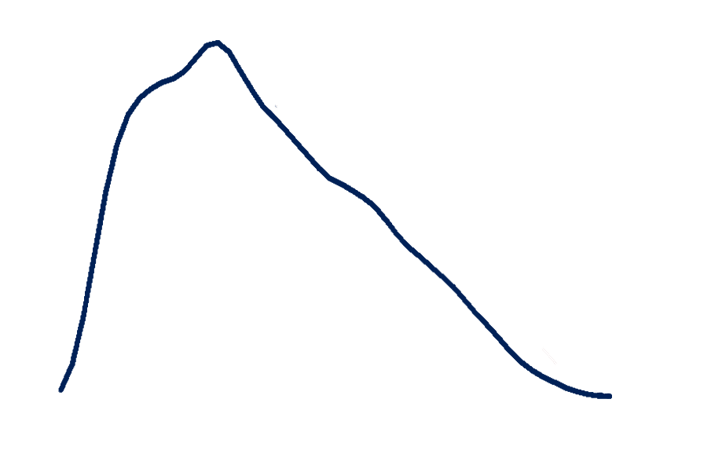
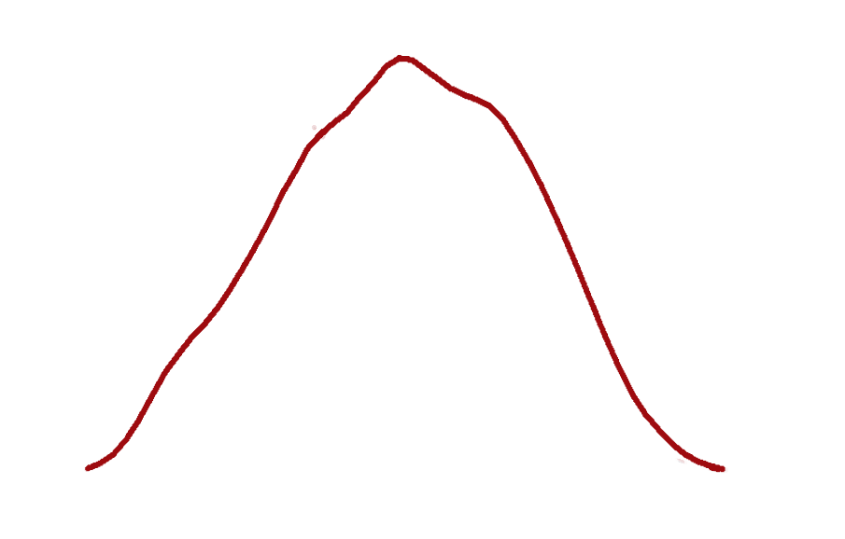
Case 7: Progresa Common Support
Density: Pr (Enrolled)
Density: Pr (Enrolled)
Density: Pr (Enrolled)
Pr (Enrolled)

Slide 95
Case 7: Progresa Matching (P-Score)
Estimated Impact on Consumption (Y)
Multivariate Linear Regression | 7.06+
Note: If the effect is statistically significant at the 1% significance level, we label the estimated impact with 2 stars (**). If significant at 10% level, we label impact with +

Slide 96
Keep in Mind
!
Matching
Matching requires large samples and good quality data.
Ex-post matching is risky:
If there is no baseline, be careful!
matching on endogenous ex-post variables gives bad results.
Matching at baseline can be very useful:
Know the assignment rule and match based on it
combine with other techniques (i.e. diff-in-diff)

Slide 97
Progresa Policy Recommendation?
Impact of Progresa on Consumption (Y)
Case 1: Before & After | 34.28**
Case 2: Enrolled & Not Enrolled | -4.15
Case 3: Randomized Assignment | 29.75**
Case 4: Randomized Promotion | 30.4**
Case 5: Discontinuity Design | 30.58**
Case 6: Differences in Differences | 25.53**
Case 7: Matching | 7.06+
Note: If the effect is statistically significant at the 1% significance level, we label the estimated impact with 2 stars (**). If significant at 10% level, we label impact with +

Slide 98
Progresa Policy Recommendation?
Impact of Progresa on Consumption (Y)
Case 1: Before & After | 34.28**
Case 2: Enrolled & Not Enrolled | -4.15
Case 3: Randomized Assignment | 29.75**
Case 4: Randomized Promotion | 30.4**
Case 5: Discontinuity Design | 30.58**
Case 6: Differences in Differences | 25.53**
Case 7: Matching | 7.06+
Note: If the effect is statistically significant at the 1% significance level, we label the estimated impact with 2 stars (**). If significant at 10% level, we label impact with +

Slide 99
2
Randomized Assignment
Randomized Promotion
Discontinuity Design
Combinations of methods
Difference-in-Differences
Diff-in-Diff
IE Methods Toolbox
Matching
P-Score matching

Slide 100
Where Do Comparison Groups come from?
The rules of program operation determine the evaluation strategy.
We can almost always find a valid comparison group if:
the operational rules for selecting beneficiaries are equitable, transparent and accountable;
the evaluation is designed prospectively.

Slide 101
Operational rules and prospective designs
Use opportunities to generate good comparison groups and ensure baseline data is collected.
3 questions to determine which method is appropriate for a given program
Money: Does the program have sufficient resources to achieve scale and reach full coverage of all eligible beneficiaries?
Targeting Rules: Who is eligible for program benefits? Is the program targeted based on an eligibility cut-off or is it available to everyone?
Timing: How are potential beneficiaries enrolled in the program – all at once or in phases over time?

Slide 102
Choosing your IE method(s)
Money | Excess demand |  | No Excess demand
Targeting Timing | Targeted | Universal | Targeted | Universal
Phased Roll-out | 1 Randomized assignment 4 RDD | 1 Randomized assignment 2 Randomized promotion 3 DD with 5 Matching | 1 Randomized Assignment 4 RDD | 1 Randomized assignment to phases 2 Randomized Promotion to early take-up 3 DD with 5 matching
Immediate Roll-out | 1 Randomized Assignment 4 RDD | 1 Randomized Assignment 2 Randomized Promotion 3 DD with 5 Matching | 4 RDD | If less than full Take-up: 2 Randomized Promotion 3 DD with 5 Matching

Slide 103
Remember
“
The objective of impact evaluation is to estimate the causal effect or impact of a program on outcomes of interest.

Slide 104
Remember
“
To estimate impact, we need to estimate the counterfactual.
what would have happened in the absence of the program and
use comparison or control groups.

Slide 105
Remember
“
We have a toolbox with 5 methods to identify good comparison groups.

Slide 106
Remember
“
Choose the best evaluation method that is feasible in the program’s operational context.

Slide 107
Portuguese and Spanish Versions also available www.worldbank.org/ieinpractice
Reference

Slide 110
Appendix 1 Two Stage Least Squares (2SLS)
Model with endogenous Treatment (T):
Stage 1: Regress endogenous variable on the IV (Z) and other exogenous regressors:
Calculate predicted value for each observation: T hat

Slide 111
Appendix 1 Two Stage Least Squares (2SLS)
Stage 2: Regress outcome y on predicted variable (and other exogenous variables):
Need to correct Standard Errors (they are based on T hat rather than T)
In practice just use STATA – ivreg.
Intuition: T has been “cleaned” of its correlation with ε.

Slide 112
Appendix 2 Steps in Propensity Score Matching
Representative & highly comparables survey of non-participants and participants.
Pool the two samples and estimated a logit (or probit) model of program participation.
Restrict samples to assure common support (important source of bias in observational studies)
For each participant find a sample of non-participants that have similar propensity scores
Compare the outcome indicators. The difference is the estimate of the gain due to the program for that observation.
Calculate the mean of these individual gains to obtain the average overall gain.

